Slide 1
Web 2.0 tools – An introduction to Voki and Glogster
Workshop activities at CS Kleitoria 2011
Sakis Pantazis – Hellenic NSS

Slide 2
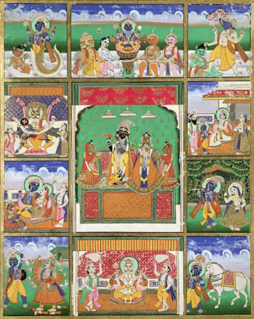
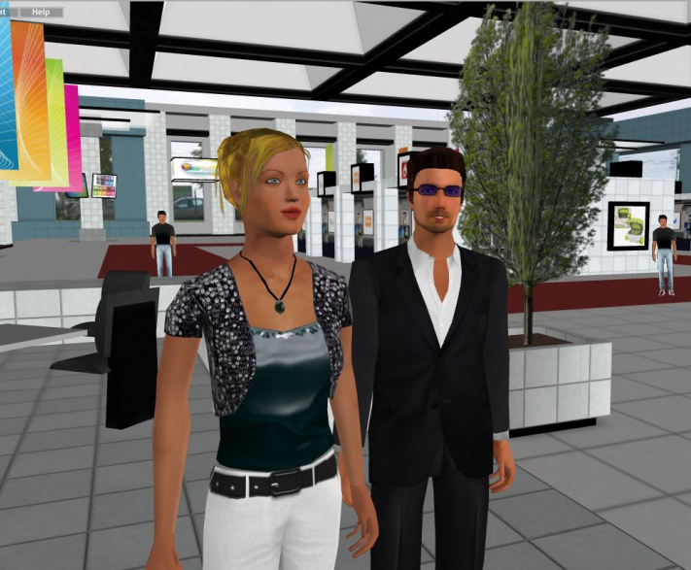
Avatar
In Hinduism, an avatar (English: /ˈæv.ə.tɑːr/, from Sanskrit avatāra, अवतार in the Devanagari script, meaning "descent") is a deliberate descent of a deity to earth, or a descent of the Supreme Being (i.e., Vishnu for Vaishnavites) and is mostly translated into English as "incarnation," but more accurately as "appearance" or "manifestation".
In computing, an avatar is the graphical representation of the user or the user's alter ego or character. It may take either a three-dimensional form, as in games or virtual worlds, or a two-dimensional form as an icon in Internet forums and other online communities. It can also refer to a text construct found on early systems such as MUDs. It is an object representing the user. The term "avatar" can also refer to the personality connected with the screen name, or handle, of an Internet user.

Slide 3
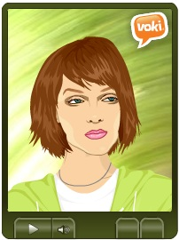
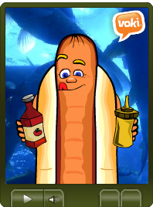
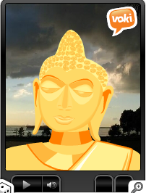
Voki
Web 2.0 tool at www.voki.com based on Adobe Shockwave-Flash technology
  Make sure you have the latest Adobe Flash Player and Adobe Shockwave Player plugins installed on your browser (www.adobe.com )
FREE service that lets you:
  Create customized avatars.
  Add voice to your Voki avatars.
  Post your Voki to any blog, website, or profile.
  Take advantage of Voki's learning resources.
“Voki classroom”- pay service to manage class
  Manage Students, Manage Classes & Lessons, Review Vokis, Showcase, Support

Slide 4
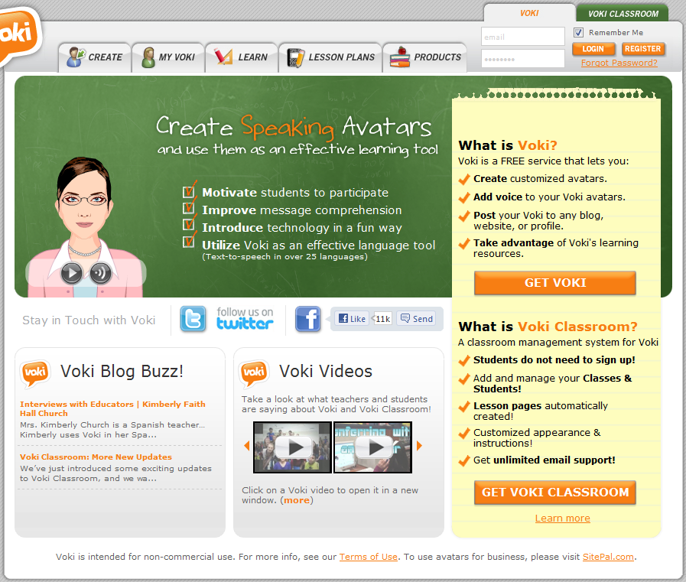
The Voki website

Slide 5
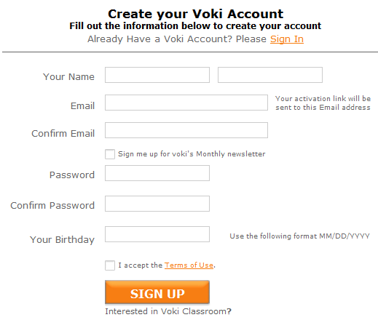
Step 1: Create a free Voki account
Click on “GET VOKI” button
Fill out the “Create your Voki Account” form
Use a valid email account
Activate your Voki account following the respective link inside the notification email.

Slide 6
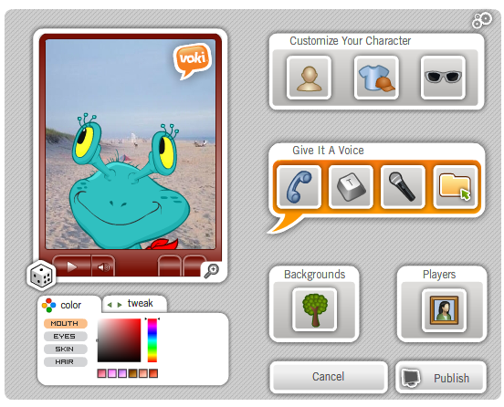
Step 2: Create and customize your Voki scene
Character Style
  Select a character from one of our many styles: Classic, Animals, Oddballs and more!
Customization
    Change the look, clothing and accessories.
Voice
    Add your own voice via phone, microphone, text to speech or upload a file.
Background
    Choose a background from our library or upload your own.

Slide 7
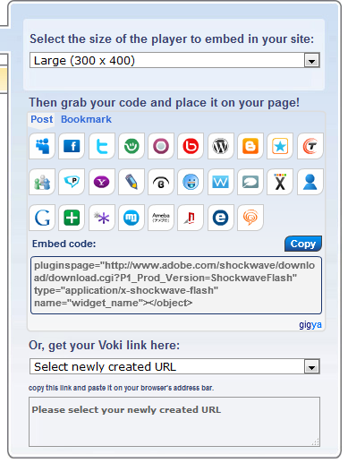
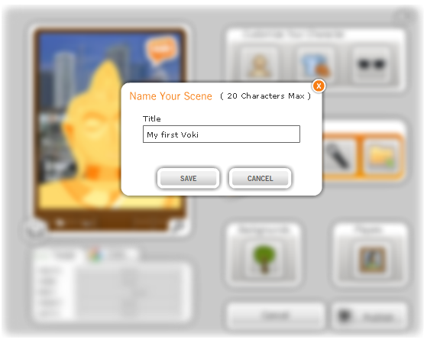
Step 3: Save and Publish your Voki scene
Name your Voki scene and save it inside your Voki account
Add your Voki to a website
  Directly posting it to a website (i.e. Facebook, blogspot, twitter, etc.)
  Indirectly posting it by copying/pasting the HTML code

Slide 8
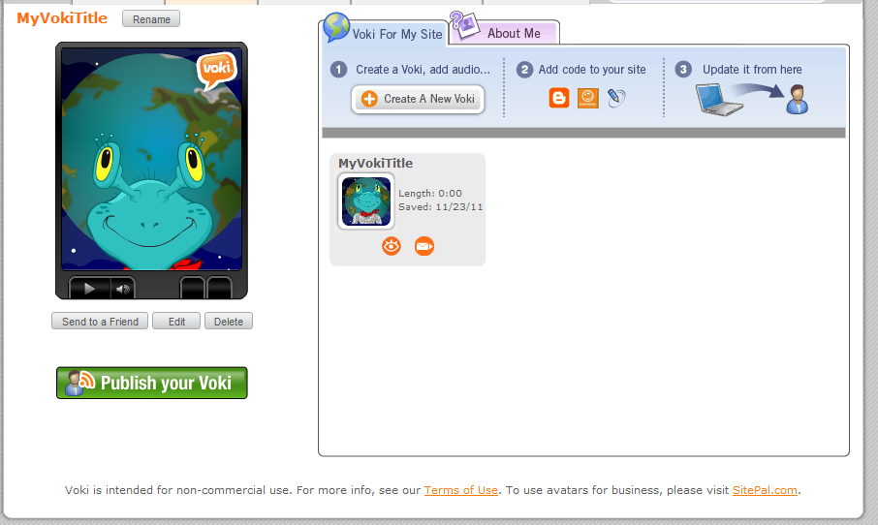
Step 4: Edit your Voki scene

Slide 9
Workshop activity on Voki:
Checkout our voki on the CS Kleitoria Twinspace
Goto www.voki.com and create a Voki account
Login to your Voki account
  Create a voki scene
  Customize the voki character using all features at least once
  Upload files for background and/or voice
  Alternatively record your voice
  Save your voki scene
Publish your voki scene
  Directly to a social network website, e.g. FaceBook
  Indirectly using HTML code, e.g. to your Twinspace
Edit your voki
  Change your voice message and/or other features of your voki scene

Slide 10
Blog
  a blend of the term web log - type of website or part of a website supposed to be updated with new content from time to time.
  maintained by an individual with regular entries of commentary, descriptions of events, or other material such as graphics or video.
  entries are commonly displayed in reverse-chronological order.
  can also be used as a verb, meaning to maintain or add content to a blog.
  good quality blogs are interactive, compared to static webpages, allowing visitors to leave comments and even message each other via widgets on the blogs
  usage: provide commentary on a particular subject; personal online diaries; online brand advertising of a particular individual or company
  types: primarily textual, although some focus on art (art blog), photographs (photoblog), videos (video blogging or vlogging), music (MP3 blog), and audio (podcasting).
  microblogging is another type of blogging, featuring very short posts.

Slide 11
Glogster
Glogster (www.glogster.com since 2007)
social network that allows users to create free interactive posters, or glogs, short for graphical blog, i.e. an interactive multimedia image. It looks like a poster, but readers can interact with the content
over one million registered users – majority are teenagers
provides environment to design interactive posters by inserting text, images, photos, audio (MP3), videos, special effects and other elements to generate a multimedia online creation
based on flash elements (install latest Adobe Flash Player plugin for your browser from www.adobe.com).
posters can be shared with other users on the site, embedded in external wikis or blogs, and shared via many social networks such as Facebook and Twitter.
glogs can also be exported and saved to computer-compatible formats.
Glogster EDU (edu.glogster.com)
Launched in 2009, Glogster EDU allows teachers and pupils to use glogs as instructional aids and share their Glogs in safe, private virtual classroom.
User licensing
  Free single license account
  Subscription fee for teacher account with student accounts and additional features (i.e. email and chat support, student management, class management, project management, creation tools, organization and extra features)

Slide 12
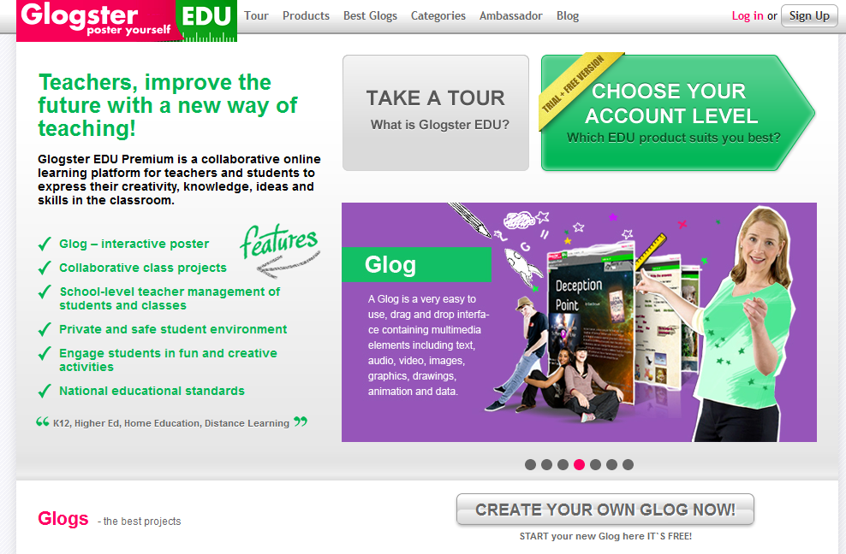
edu.gloster.com

Slide 13



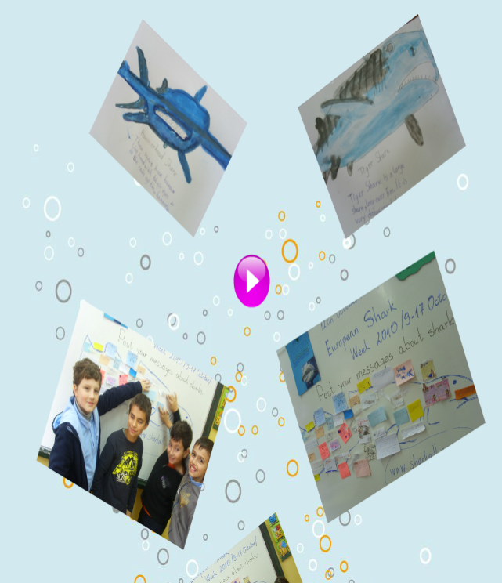
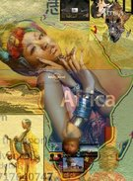
Glog samples

Slide 14
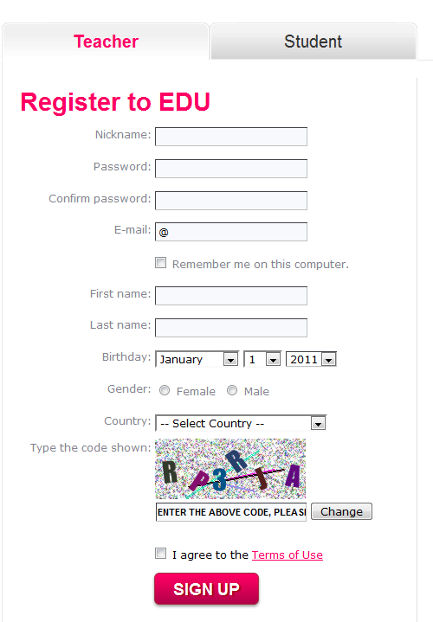
Step 1: Create an edu glogster account
  At the Free Single License column click on the “GET IT” button
  Fill out the “Register to EDU” form
  Choose a nickname (not already used)
  Use a valid email account
  Activate your Glogster account following the respective link inside the notification email.
  Login using your nickname and password

Slide 15
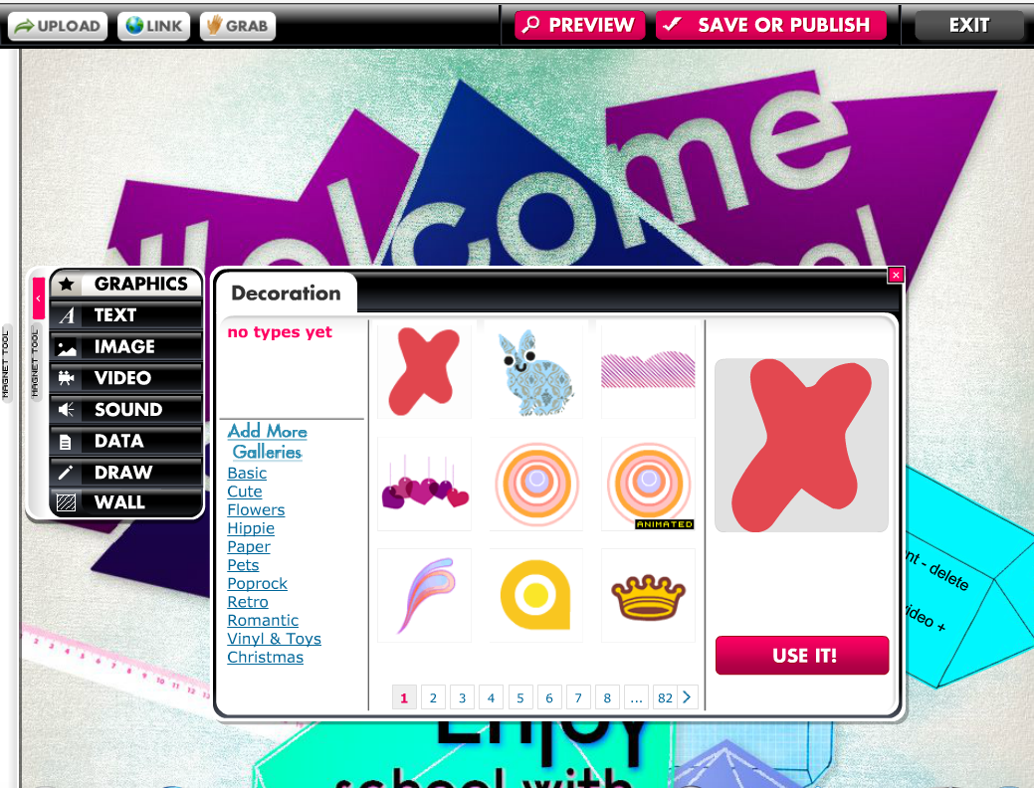
Step 2: Start a glog/poster
Click on the “CREATE NEW GLOG” button
Use the “Magnet Tool” to add multimedia objects on your poster
Choose objects from build in galleries or upload your own (i.e. upload files, specify links or grab your audio or video)
Tip: Start from the wall

Slide 16
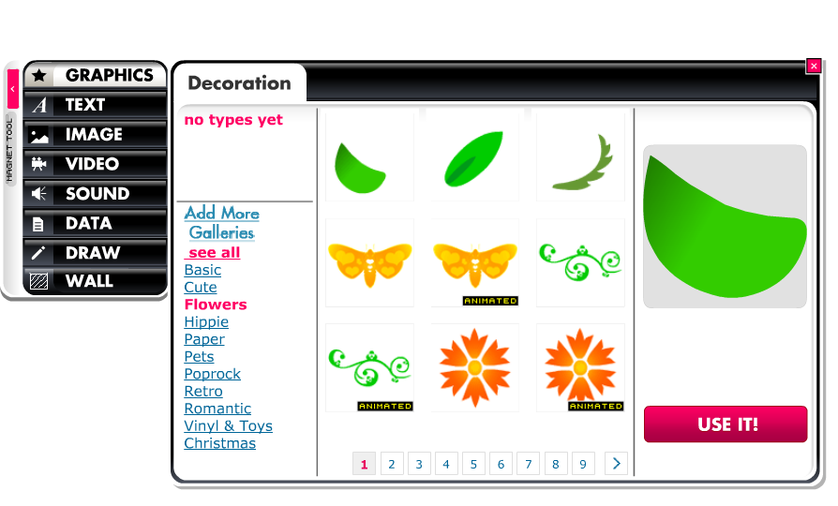
Step 3a (i): Adding gallery multimedia objects

Slide 17
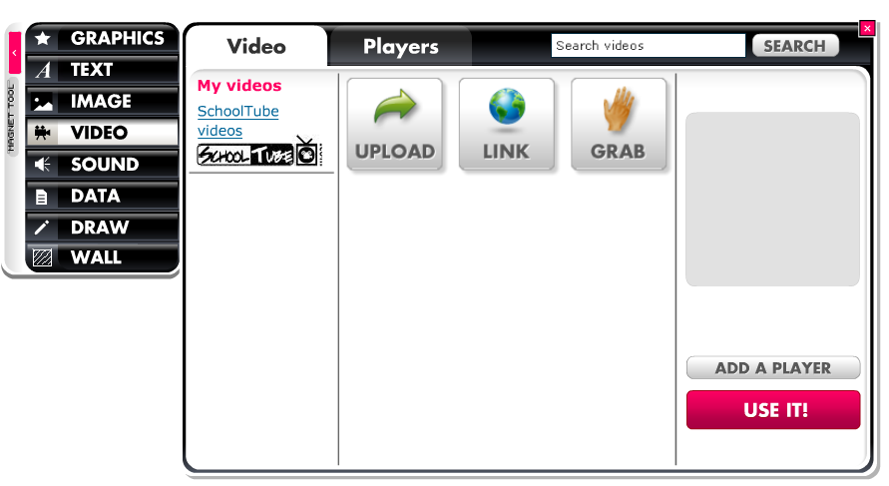
Step 3a(ii): Adding your multimedia objects

Slide 18
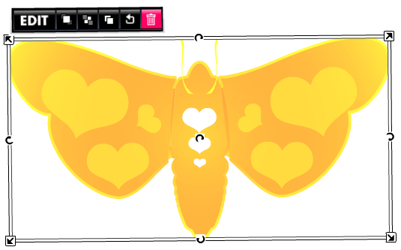
Step 3b: Edit multimedia objects
Click on the object
Use the object’s “EDIT” toolbar in order to
  bring it forward
  put it behind
  clone
  cancel changes
  delete
Use the object handles to
  resize
  rotate
  move
  the object

Slide 19
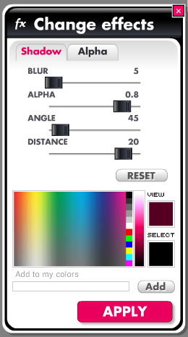
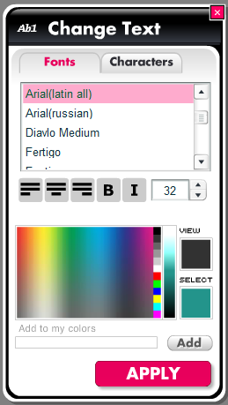
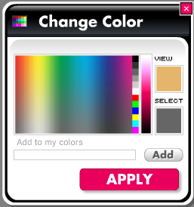
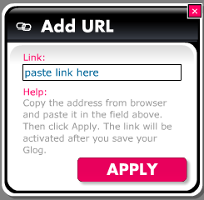
Step 3c: Customize multimedia objects
Click on the “EDIT” button of the edit toolbar to get a customization toolbar in order to
  change the graphics color
  add a link
  change effects
  change text/font/color (for text only)

Slide 20
Step 4: Main menu bar
Upload files from your local computer
Link to files already uploaded somewhere else
Grab audio or video from your microphone and/or webcam
Preview your glog while working
Save and Publish your glog
Exit from edit mode to the Dashboard (management mode)

Slide 21
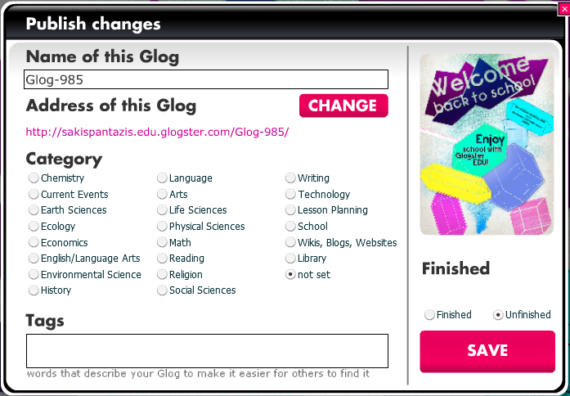
Step 5: Save and publish your glog
Name your glog
Check out the URL (address) of your glog
Choose the Category
Add your own tag
Save
  Unfinished
  Finished

Slide 22
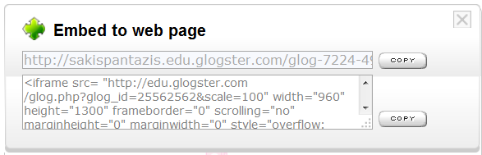
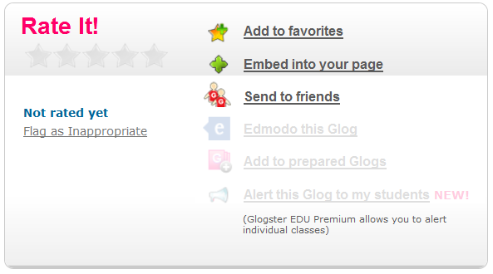
Step 5: Embed it in your web page

Slide 23
Workshop activity on Glogster:
Go to edu.glogster.com and create a Glogster account
Login to your Glogster account
  Create a glog
  Add multimedia objects from the galleries , upload your own and grab a video from your webcam.
  Customize the glog multimedia objects
  Preview your glog
  Save your glog (i.e. name, category, tag, finish/unfinished)
Share your glog
  Provide the URL address
  Indirectly using embed HTML code, e.g. in your Twinspace
Edit your glog
  Change your voice message and/or other features of your voki scene
Checkout edu glogster’s pay service features
Create student accounts (one-by-one and excel mass import tutorial)

