Slide 1




From Collaboration to Transformation: How eTwinning shapes digital, STEM and AI-ready teachers
Michael Paraskevas,
Professor at the University of Peloponnese,
Vice President of the CTI "Diophantus",
Head of the National Support Organization eTwinning

Slide 2
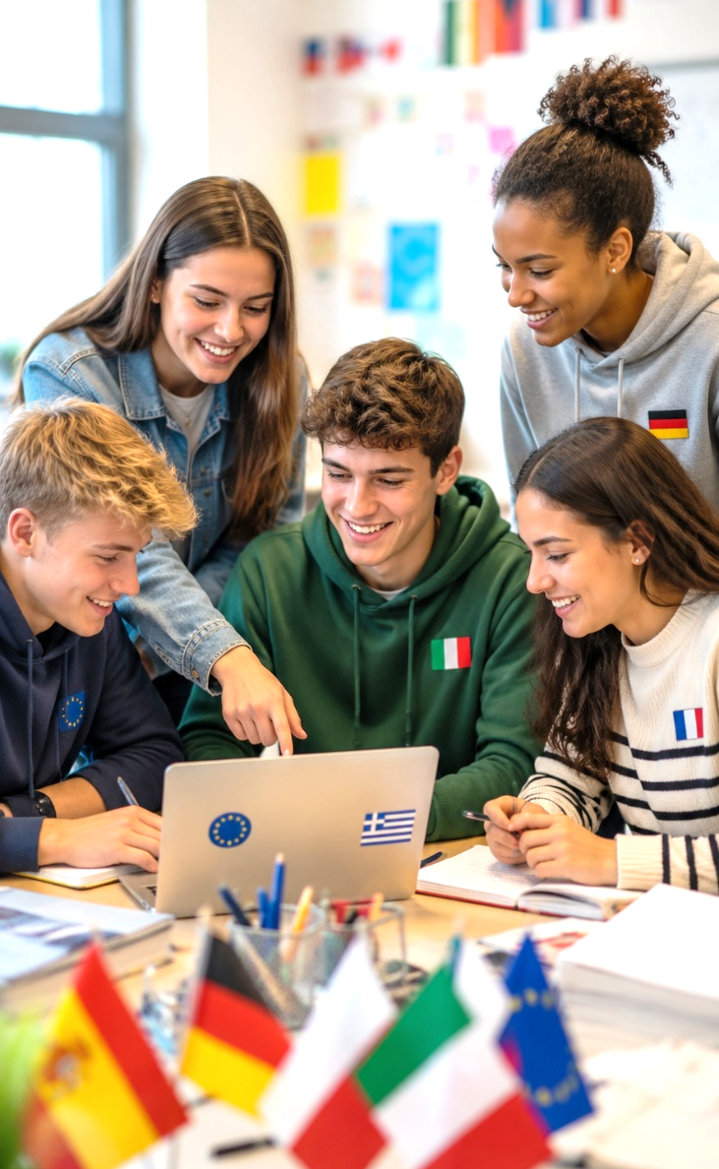
What is eTwinning?
eTwinning is the Community for Schools in Europe
European school cooperation action since 2005
Safe digital environment for collaborative projects
Teachers and students from different countries work together
Promotes cooperation, creativity, digital skills, intercultural understanding and European identity

Slide 3

eTwinning in Numbers
A European community with strong Greek participation
Europe
45 countries
1,300,000+ teachers in total
300,000+ schools in total
160,000+ projects in total
330,000+ active teachers
200,000+ active schools
Greece
58,000+ teachers in total
15,000+ schools (all)
26,000+ projects in total (16,5%)
28,000+ active teachers (15%)

Slide 4

Is eTwinning Successful in Greece?
The Greek success model
eTwinning in Greece succeeded because it did not operate only as a platform, but as an organized ecosystem.
  Key factors
  Systematic pedagogical and technical support
  Large-scale professional development for teachers
  Active network of eTwinning Ambassadors
  Connection with innovation, STEM, AI and
  European values
  Recognition and reward of quality

Slide 5





Is eTwinning Successful in Greece?
Recognition & Rewards
• Labels
• Awards
Support
• Pedagogical
• Technical
Professional Development
• MOOCs, webinars
• Open courses
• PDW, Contact Seminars

Slide 6

National Support Organization (NSO) of eTwinning
The Hellenic NSO of eTwinning:
  Operates under the responsibility of CTI “Diophantus”, in cooperation with the Ministry of Education.
  Provides pedagogical, technical and organizational support to teachers.
  Supports registrations, ESEP, TwinSpace, projects, Quality Labels and awards.
  Organizes training, information activities and the sharing of good practices.
  Coordinates the network of eTwinning Ambassadors.
  Turns a European action into a living and active national community.

Slide 7

A Community with Continuous Support
From registration to a quality project
Support in using ESEP and TwinSpace
Help with registrations, projects and Quality Labels
Recognition and rewards through Quality Labels and awards
Pedagogical guidance for designing collaborative projects
Technical support through an organised helpdesk
Continuous communication with teachers and schools

Slide 8

Strategic Goals of the Hellenic NSO
Improve the quality of eTwinning projects
Increase teacher participation
Support teachers
Support Higher Education Institutions
Strengthen teachers’ digital skills, especially in AI

Slide 9

eTwinning Ambassadors
Are experienced volunteer teachers with active participation in the action
Support teachers in their areas of responsibility
Organize webinars, face-to-face events and workshops
Guide teachers in designing quality collaborative projects
Share good practices and strengthen the community

Slide 10
Webinars & Training Activities by Ambassadors
Large-scale, decentralized and targeted support
Activity 2022-2026:
554 online training sessions
35,777 teacher participations
Topics: ESEP, TwinSpace, project quality, eTwinning Schools, digital tools, Skills Labs, Initial Teacher Education, etc.
A combination of information, guidance and motivation

Slide 11

Professional Development for Teachers
The community grows when teachers are empowered
Webinars and Ambassador events
Long-duration open online courses
MOOCs for broad and flexible access
Pedagogical guides
PDW and Contact Seminars at European level
Special topics: STEM, AI, Initial Teacher Education

Slide 12

Open Online Courses
Structured, long-duration training
18 online courses, 200 hours each
Annual cycles from October to April
Topics: ICT, Web 2.0, multimedia, mobile devices, educational robotics - STEM, AI, interactive learning systems, etc.
Free or open source tools and permanently available training material
More than 1,500 volunteer trainers

Slide 13
The Scale of the Open Courses
More than 99,350 registrations in five (5) school years
School year 2026-27: three (3) new courses:
“R1: Game-Based Learning, Computational Thinking and Educational Robotics in Kindergarten”
“Educational Technology, Design Thinking and Active Citizenship”, in cooperation with Aristotle University of Thessaloniki.
“Creating an eTwinning Project - Quality Criteria” - compulsory course

Slide 14

Quality and Measurable Impact
Training changes digital skills
Evaluation using the Selfie4Teachers methodology
(official tool of European Commission)
Improvement in digital skills was recorded:
  Trainees: +17% (37% to 54%)
  Trainers: +15% (60% to 75%)
Connection between training and classroom practice
Skills for collaborative eTwinning projects

Slide 15

Online Courses in English
The Greek experience as support for other communities
Courses in English
Topics: AI (I & II), Arduino Basic
Offered to teachers of European Schools
(88 registrations)
Support training of eTwinners from 8 countries: Albania, Cyprus, Ireland, Jordan, North Macedonia, Palestine, Turkey, Tunisia (183 registrations)
International use of the expertise of the Hellenic NSO

Slide 16


MOOCs eTwinning
No. | MOOC title | Offered | Trained participants (teachers, students)
1 | “eTwinning & Skills Labs: Collaborative Actions for Developing Knowledge, Skills and Competences” | 2022, 2023 (2025, 2026 self-paced) | 8.069
2 | “Introduction to eTwinning, the European Action for Education” | 2023 (2025, 2026 self-paced) | 7.087
3 | “The European eTwinning Action in Higher Education” | 2024 (2025, 2026 self-paced) | 1.214
4 | “Designing a Quality Collaborative eTwinning Project” | 2024 | 1.911
5 | “Using AI in Education and in eTwinning Projects” | 2025 | 3.029
Total |  |  | 21.310

Slide 17




Cooperation with Educational Policy Bodies
eTwinning within the national education ecosystem
Institute of Educational Policy: Connection with Skills Labs
State Scholarships Foundation (NA Erasmus+): Promotion of KA1/KA2 mobility and cooperation actions in schools
National Digital Skills Academy: Nine (9) digital courses for developing digital skills
National Centre for Public Administration and Local Government (EKDDA): Free eTwinning courses for teachers

Slide 18
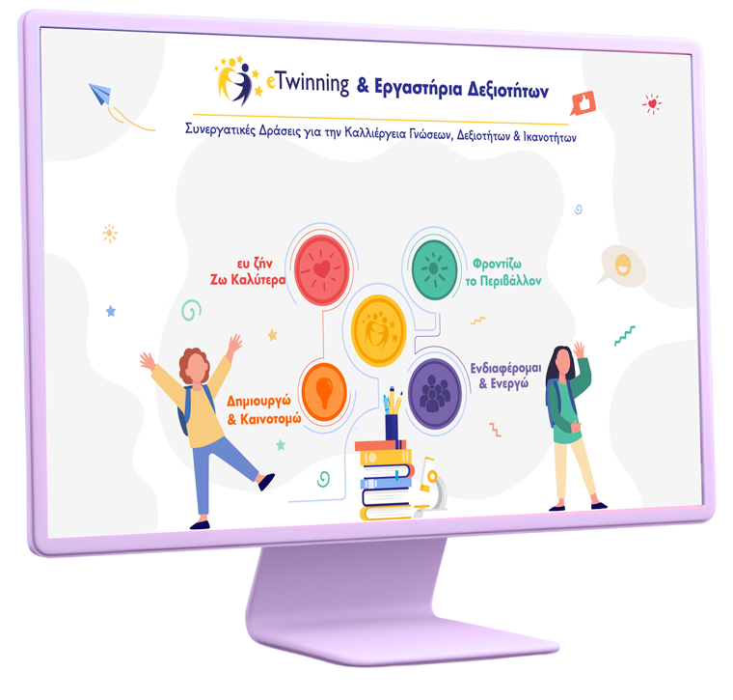
eTwinning and Skills Labs
Turning national actions into collaborative European projects
Cooperation with the Institute of Educational Policy
MOOC (2022) on using Skills Labs through eTwinning
8,069 teachers have attended the course
Turning school activities into collaborative projects between schools
Creation and publication (2023) of an e-book with good practices

Slide 19
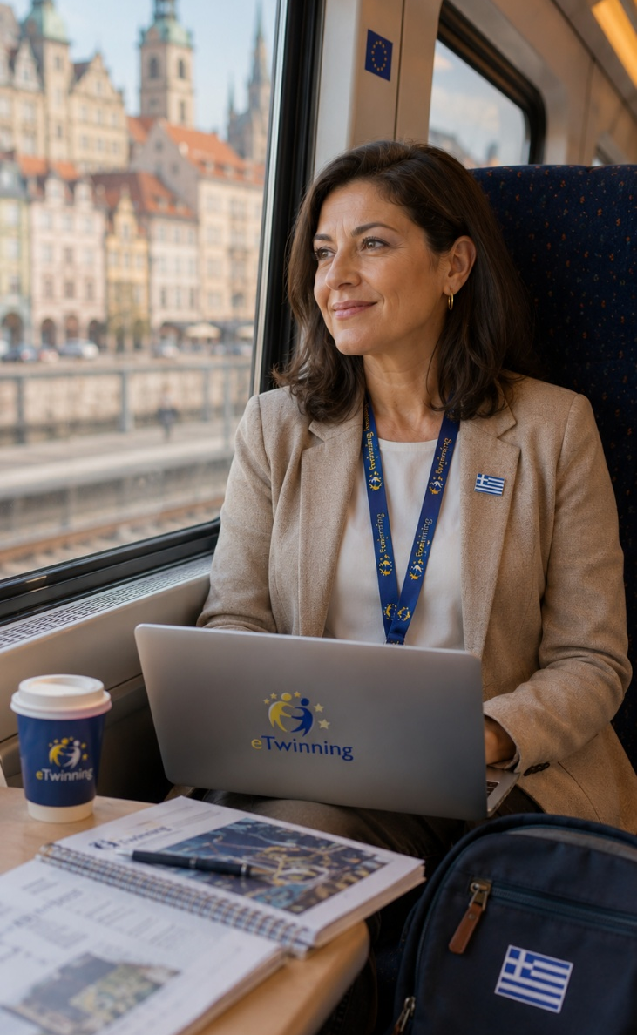
eTwinning and Erasmus+
From collaborative projects to international mobility
Cooperation with the State Scholarships Foundation (National Agency of Erasmus Plus)
Information for schools on KA1 (mobility) and KA2 (cooperation, innovation)
eTwinning as a first step in European cooperation
Development of school partnerships before larger European projects
Connection between school innovation and European mobility opportunities

Slide 20

Initial Teacher Education (ITE)
eTwinning in the education of future teachers
Cooperation with 23 education-related departments from
13 Greek universities - Support from 21 ITE Ambassadors
Integration of eTwinning into courses and in student teaching practice (37 university teachers)
Collaborative projects with students, schools and European partners (50 projects)
Students trained: 2.227
9 departments with a National QL and awards
Connection of university departments from 45 countries
Research results are published in the WELCOME journal

Slide 21

Results & Recognition
2024-2026
Education & Training
Teacher educators who integrated eTwinning | 37
Students in training activities | 1.180
Registrations in the “eTwinning ITE” MOOC | 940
Students in the asynchronous eTwinning Seminar | 107
Projects & Teaching Practice
National & European projects with students | 41
Projects in teaching practice (Kindergarten) | 8
Projects in teaching practice (Primary School) | 1
Distinctions & Awards
Departments with a National eTwinning ITE Label | 9
Participations in the European eTwinning ITE Award competition | 2
Special National eTwinning ITE Award | 3

Slide 22
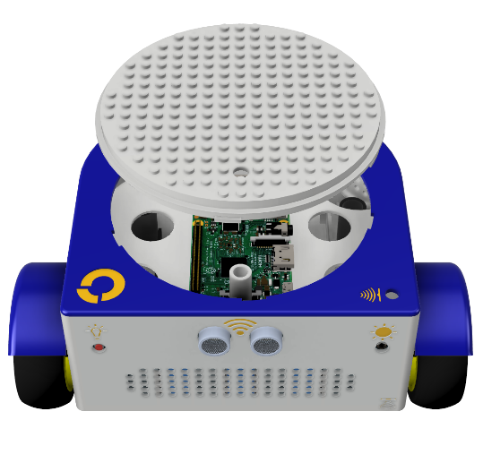

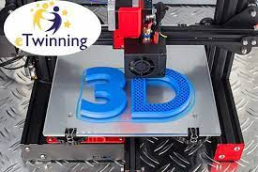
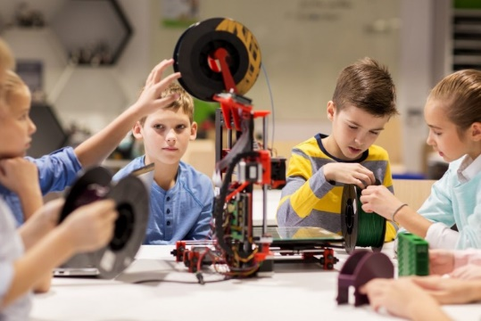
STEM @ eTwinning
Educational robotics in collaborative projects
1,000+ schools with STEM equipment and support
Selection of schools based on eTwinning criteria
Appropriate equipment according to school type
Technical and pedagogical support for STEM projects
Teacher training through open courses, MOOCs, webinars
National and European distinctions for STEM/eTwinning projects
Special STEM award in the National eTwinning Competitions
Publication of pedagogical guides (e.g. BeeBot at Kindergartens)
Articles in the WELCOME online journal

Slide 23
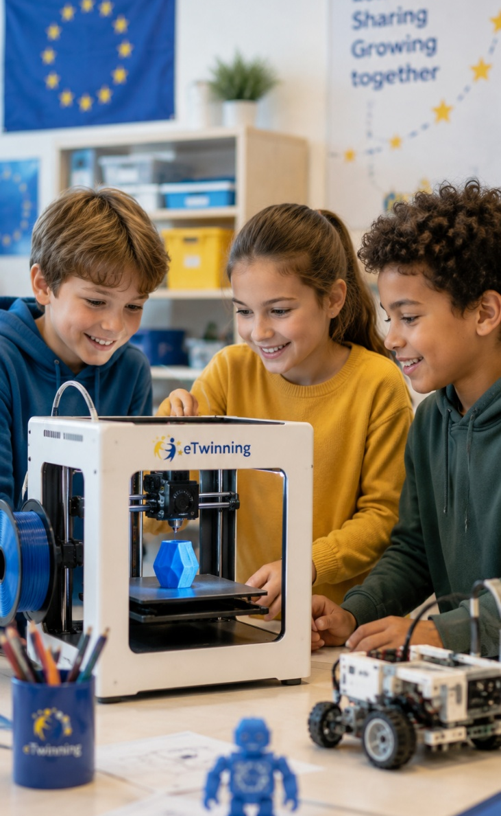
STEM 5 and Inclusion
Innovation reaches schools with greater needs
100 schools in the STEM 5 action
Special education, minority, second-chance and remote schools
Equipment:
  3D printers in 50 schools
  micro:bit kits in 50 schools
  Robotics kits in 5 university departments for student training
Connecting STEM, eTwinning and equal access to innovation

Slide 24
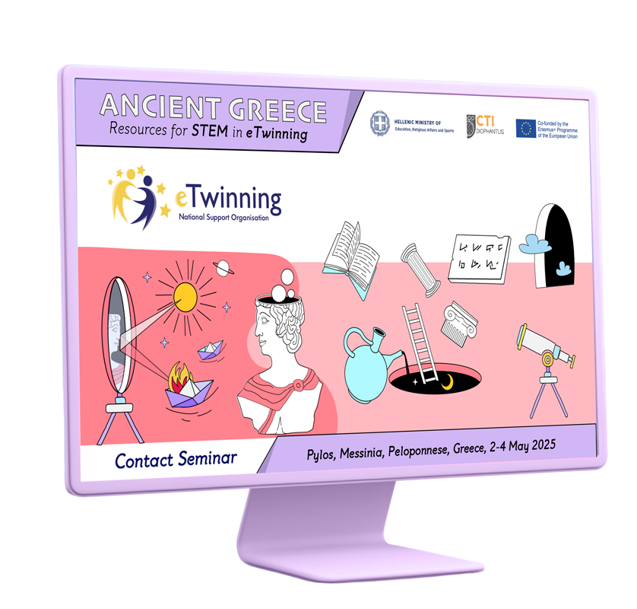
International STEM Activity
“Ancient Greece resources for STEM in eTwinning”
Multilateral Contact Seminar, Pylos, May 2025
50 eTwinning teachers from 8 European countries
Use of Ancient Greece technology as a context for STEM learning
Connection of mathematics, science, engineering, design and technology
Support for teachers in designing new European eTwinning projects
An example of linking cultural heritage, innovation and cooperation

Slide 25
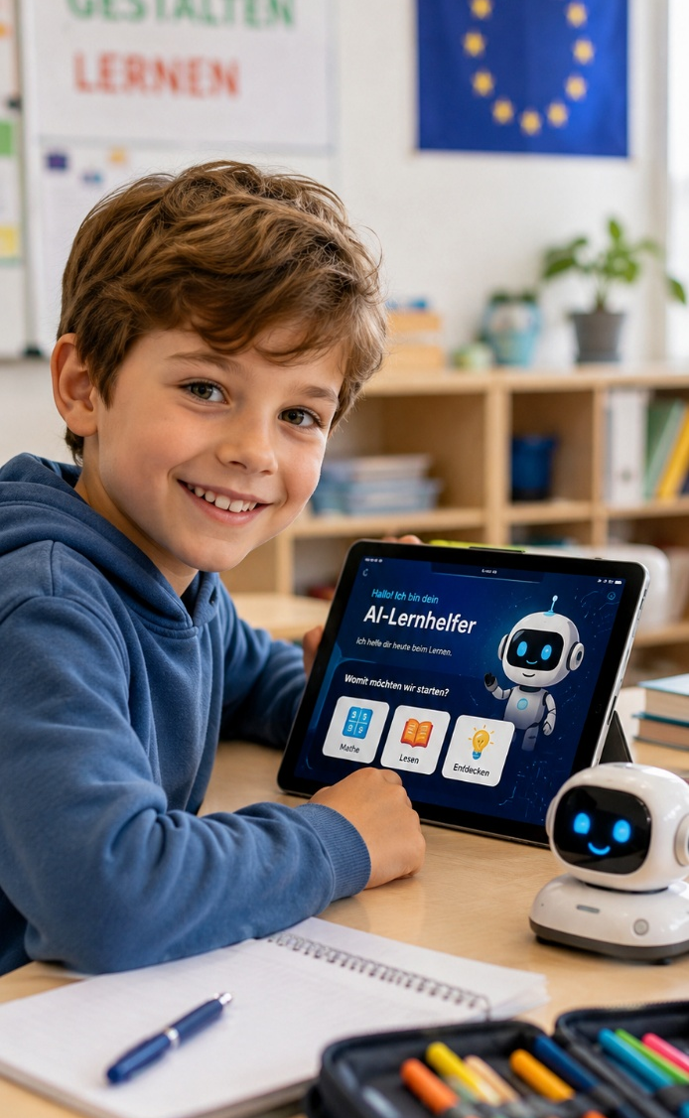
AI in eTwinning
From enthusiasm to pedagogical and responsible use
Integration of AI in eTwinning projects and school teaching
Two (2) open courses of 200 hours and two (2) MOOCs
Focus on possibilities, limitations and pedagogical uses
Attention to ethical issues
21,000+ teachers trained (2023–2026)
Policy framework for using AI in eTwinning projects (announced)
Sharing good practices through competitions, guides, the WELCOME journal and social media

Slide 26
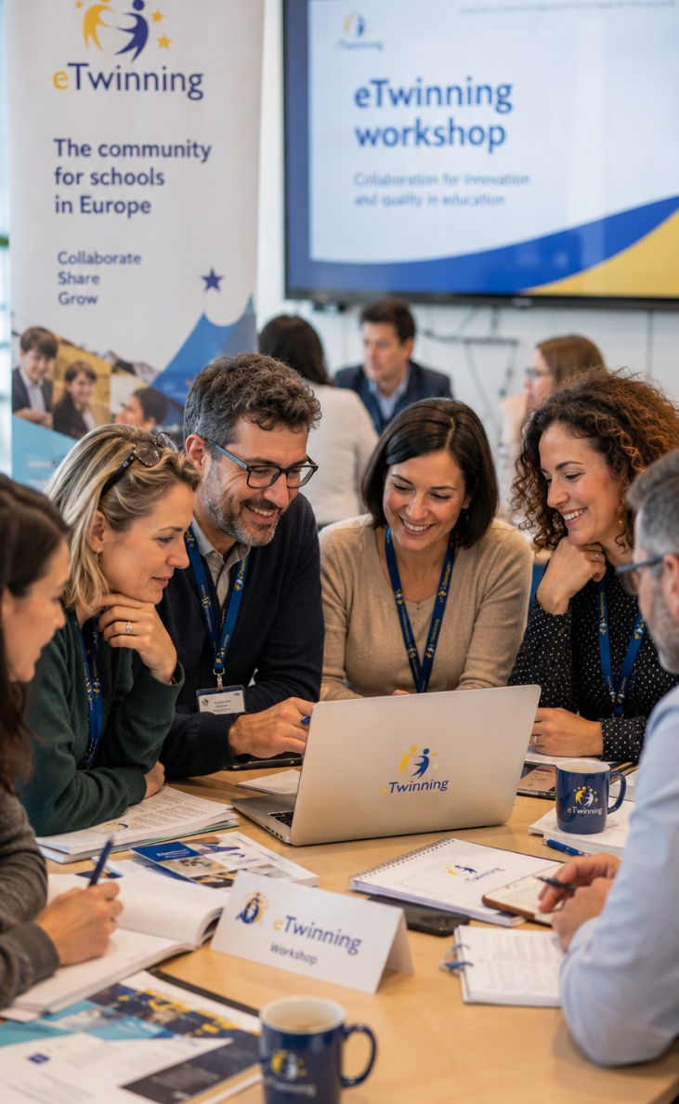
International Activity on AI
Multilateral Contact Seminar: “Applications, tools and perspectives of ΑΙ in education for Secondary School Teachers”, Patras, May 2024
70 eTwinning teachers from 13 European countries
Focus on the pedagogical integration of AI in secondary education
Talks, workshops and presentations of AI tools
Transnational communication and cooperation between teachers
Creation of new eTwinning projects on AI

Slide 27

Pedagogical Use of AI in eTwinning Projects and Classroom Teaching
COURSE
Goal: Contact with AI tools for teaching, lesson preparation and student assessment. Awareness of ethical issues linked to the introduction of AI in education.
Duration: 200 training hours (October-April).
Content: What is AI? Use of AI for teaching and for supporting students and teachers. Large language models and their use in education. Chatbots. Ethical guidelines for using AI in teaching.
2023-2026: 17,784 teachers trained (= 12,898 + 4,886).

Slide 28
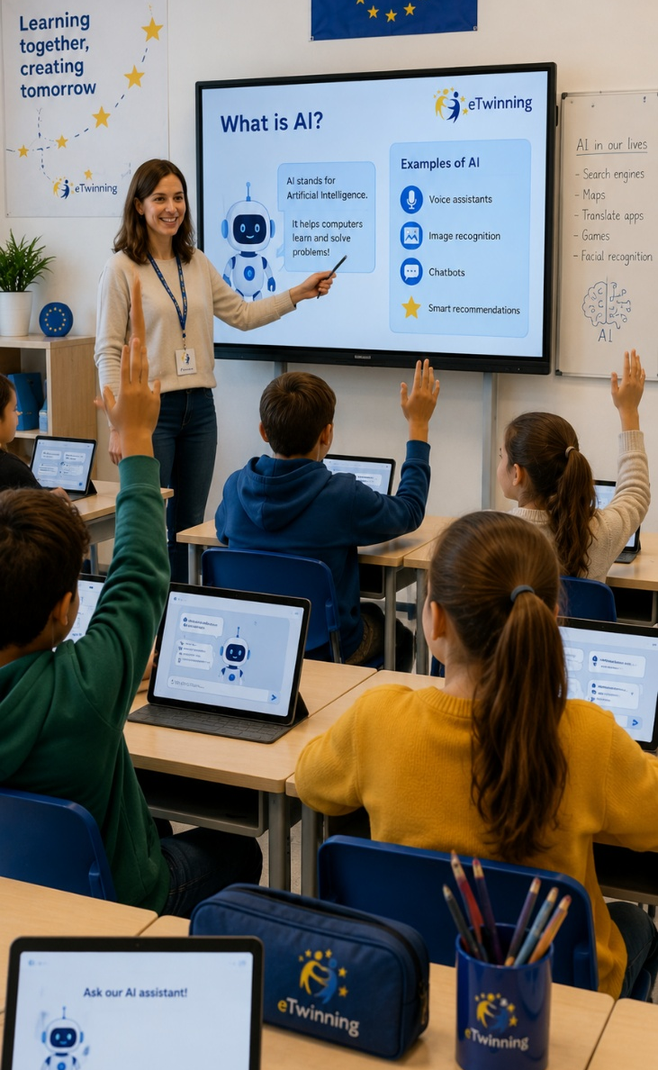
Using AI in Education and in eTwinning Projects
MOOC
Course goals
Understand the possibilities and limitations of AI in education.
Develop skills in using AI tools.
Use AI tools in eTwinning projects to improve cooperation.
Highlight ethical use of AI in the school environment.
Structure
Introduction to AI, education and eTwinning
Chatbots & Prompt Engineering
Multimedia applications and AI tools
Assessment, correction and lesson planning
Offered in 2025: 3,029 teachers trained.

Slide 29

Recognition and Rewards
European Awards
2006-present: 85+ Greek schools have been awarded in different categories.
2022-2025: 28 Greek schools and 43 teachers in European award-winning projects
3 Greek schools participated in the best projects (overall prize) at European level.
National Awards (20 in total form 2006)
2022 - 2025: 88 schools and 3 university departments were awarded
National & European Quality Label
WELCOME
Online journal
National & European eTwinning Awards
eTwinning School
Label

Slide 30
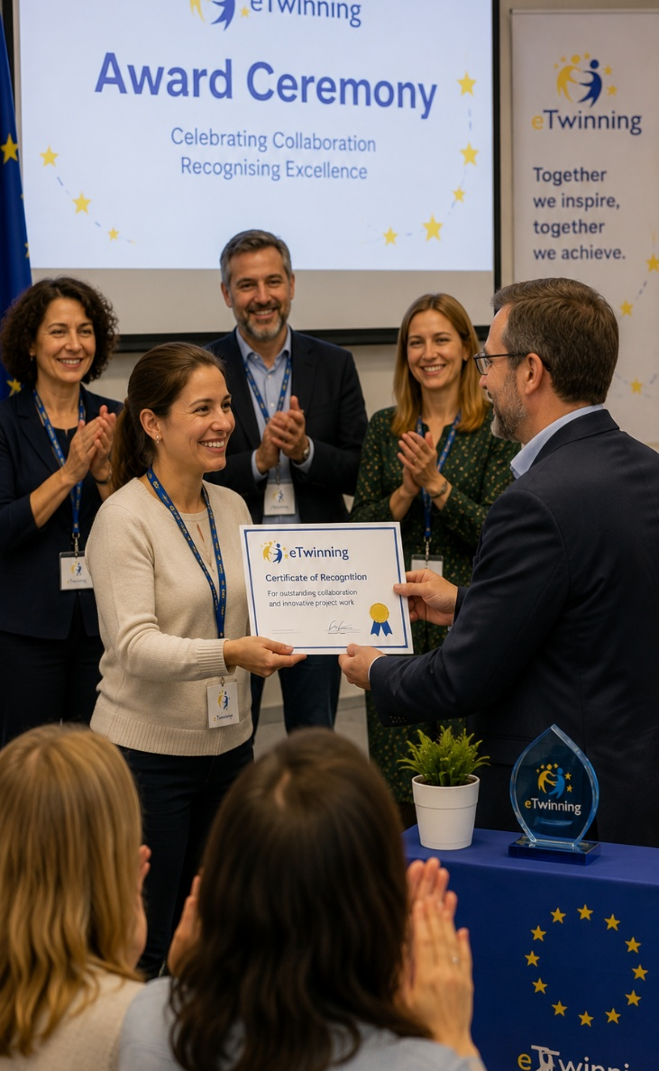
National Competitions & Awards
Recognition of quality and reward of school innovation
National Competitions:
20th (2025): 19 schools and 1 university department were awarded tablets.
19th (2024): 17 schools and 2 university departments were awarded tablets.
18th (2023): 20 schools were awarded 3D printers and tablets.
17th (2022): 32 schools were awarded 3D printers and tablets.

Slide 31
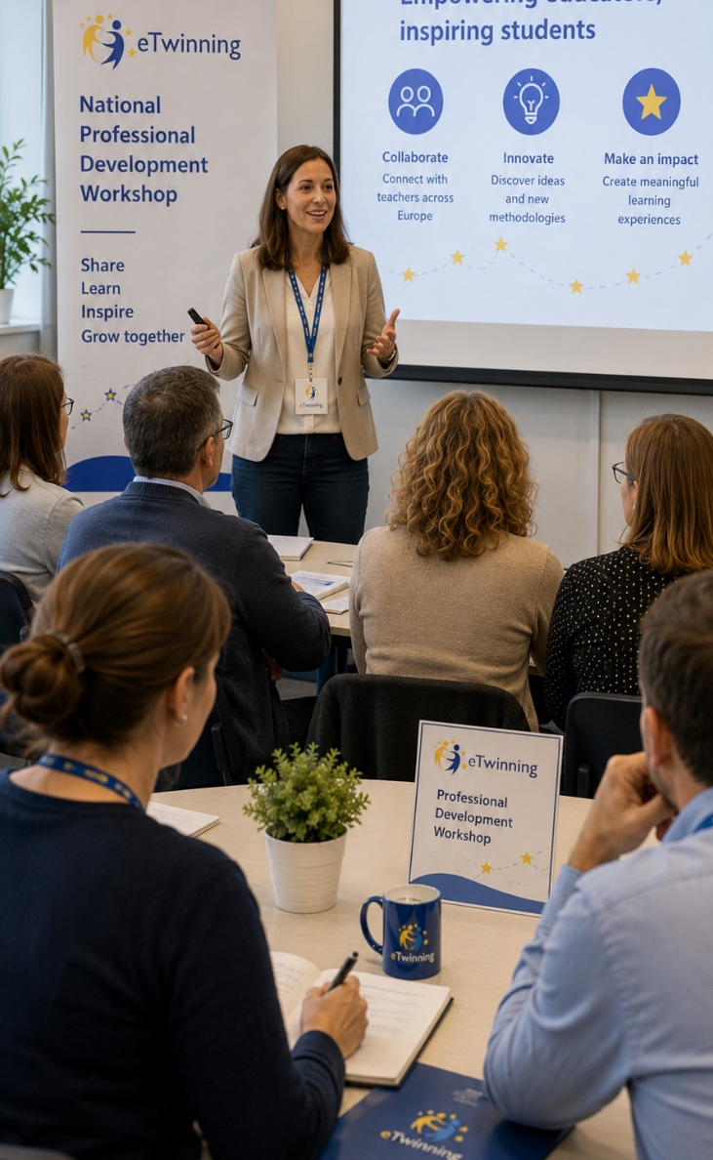
National eTwinning Conferences
The community meets, learns and shares
National Conferences:
10th (2024), Athens: 16 keynote talks, 105 presentations, 16 workshops (300 participants, 4,000+ online)
11th (2025), Thessaloniki: 8 keynote talks, 125 presentations, 19 workshops (260 participants, 4,000+ online)
Award ceremonies and sharing of good practices
12th (2026), Volos, 13-15 November 2026

Slide 32
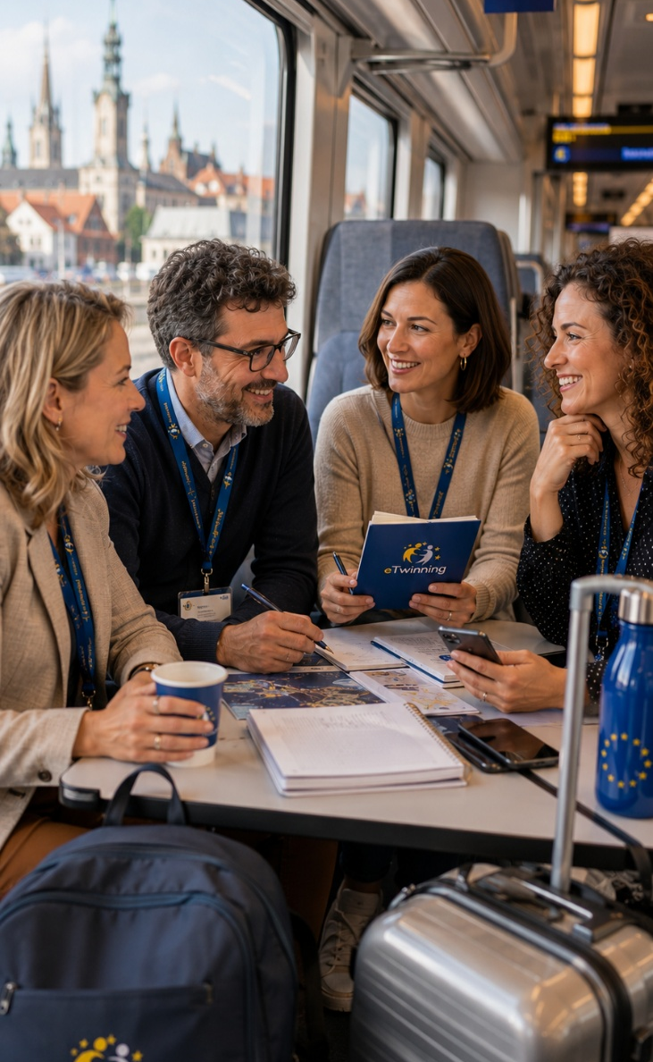
International Missions of Greek Teachers
Professional development, networking and European outreach
Participation in conferences, PDW, Contact Seminars and multilateral activities
Selection of both award-winning and new eTwinning teachers
Development of skills, partnerships and new eTwinning projects
2024-2025: 84 participations from Greece (56 teachers,
22 NSO members, 6 university teachers)
Active contribution of the Greek community through presentations and workshops

Slide 33
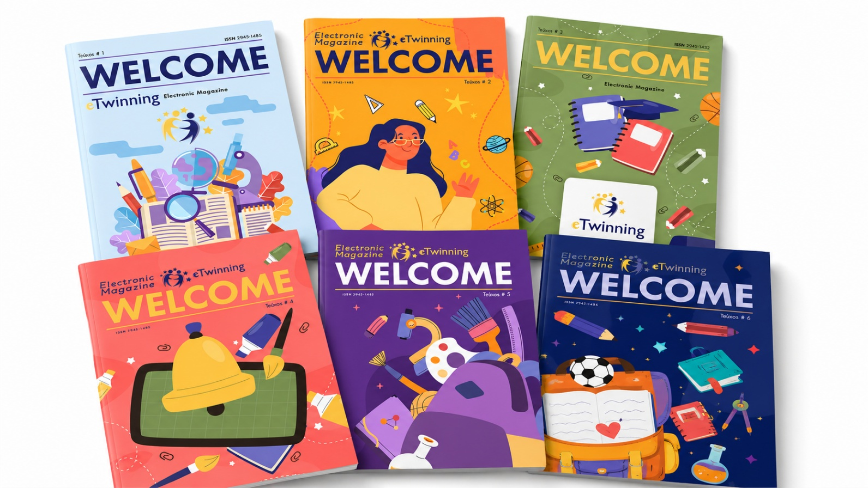
WELCOME: eTwinning Online Journal
The community creates and shares knowledge
Launch: July 2023
Two (2) issues per year | ISSN 2945-1485
6 issues and 101 articles so far
Articles by teachers, researchers, students and pupils
Open repository of good practices, educational scenarios and research papers

Slide 34
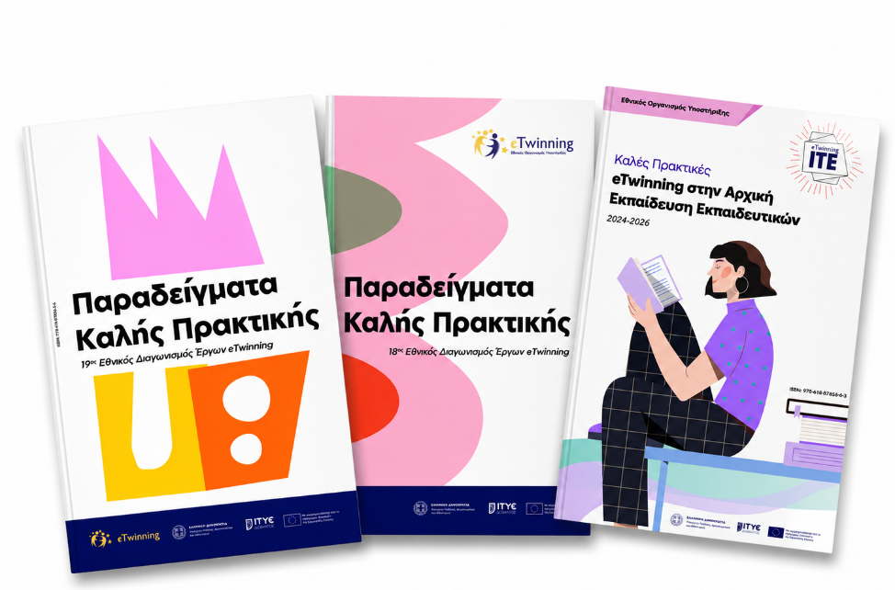
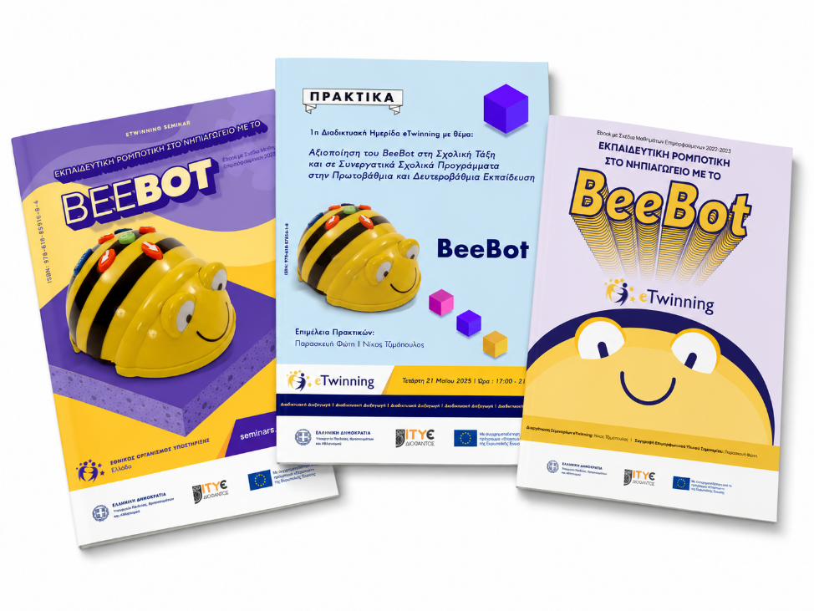
eTwinning Publications and Pedagogical Guides
From projects to pedagogical knowledge
Pedagogical guides with methods and examples
Good practices from national eTwinning competitions
Educational scenarios and activity plans
Material ready for classroom use
Publications on STEM, educational robotics and Skills Labs
Sharing experience from real eTwinning projects with the wider community

Slide 35
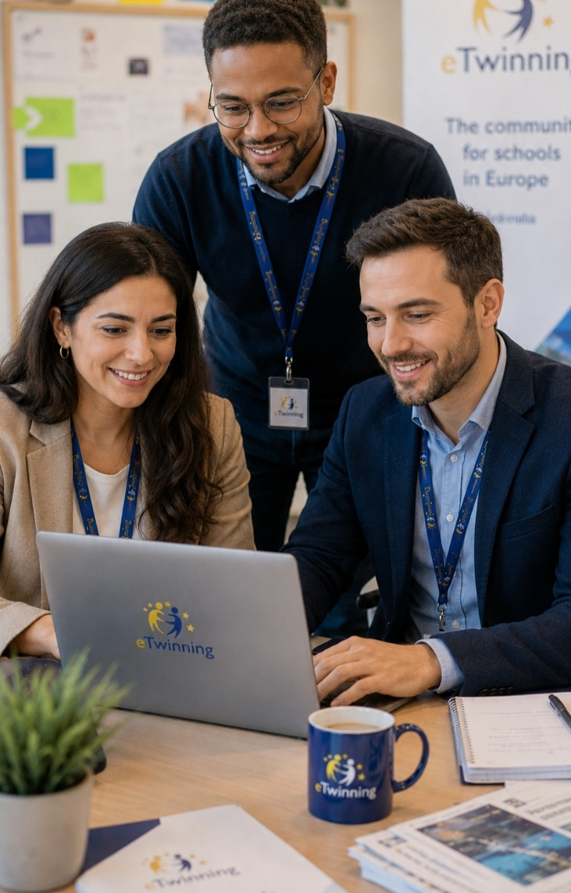
Support Mechanism
Organized support for a large and active community
Start: February 2024
Support request management system
Requests can be submitted through the platform or by email
Actions are recorded and the teacher is informed
More than 7,200 support requests so far
Main categories: ESEP, Quality Labels, awards, TwinSpace, project registrations

Slide 36

Challenges
Technical issues related to the ESEP platform
Increased workload for validation
Management of large-scale MOOCs
Growing demand for teacher training related to AI
Excellent cooperation with CSS

Slide 37

What Does the Greek Experience Teach Us?
Cooperation needs stable support
Training must be connected to classroom practice
Innovation needs a pedagogical framework
Recognition strengthens quality
eTwinning works as a laboratory for European educational change

Slide 38

Thank you !
eTwinning connects schools, empowers teachers and brings Europe into the classroom.
It turns collaboration into digital, STEM and AI-ready teaching.
eTwinning Portals
https://school-education.ec.europa.eu/el
https://www.etwinning.gr
https://seminars.etwinning.gr
https://mooc.etwinning.gr
https://welcome.etwinning.gr
https://support.etwinning.gr

